Slide 1


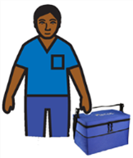
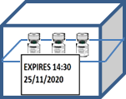
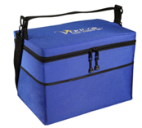
Cool Box Quick Reference Guide: COVID-19 Vaccines
Maintain the temperature between +2˚C to +8˚
Protect the vaccine from freezing
Protect the vaccine from light
Minimise excessive movement of the vaccine
Choosing Your Cool box
Preparing Your Cool box
Using Your Cool box
Consider how you intend to use your cool box
The cool box must be designed for purpose of transporting and storing vaccines, and be suitably portable
If frozen cool packs will be used, the cool box should be designed to prevent direct contact between the cool pack and the vaccine to prevent freezing
The cool boxes and cool packs must be sourced from a recognised medical supply company. Domestic cool boxes must not be used to transport vaccines.
Obtain data to ensure that your intended use of the cool box will keep the vaccine between +2˚C to +8˚C during its use. You will need to consider:
  Total intended duration of use
  Frequency and duration of openings during use (if any)
Cool packs should be chilled in accordance with the manufacturer’s instructions, to ensure they maintain the right temperature.
The box and cool packs must be carefully assembled in strict accordance with the manufacturer’s instructions
If frozen packs are specified by the manufacturer, a digital thermometer must be used to check the internal temperature of the cool box after the blocks are inserted and with lid closed to ensure it is between +2˚C to +8˚C prior to use.
If the cool box doesn’t include pockets to hold the cool blocks, a thick (1-2cm) layer of insulating material such as crumpled paper towel or bubble wrap must be used to separate the blocks from the vaccine.
Ensure that only the quantity of vaccines required for each session are removed from the vaccine refrigerator & transferred to the cool box.
The vials should be placed quickly into the cool boxes and opening times must be kept to a minimum
Vaccine vials must be packed securely to minimise movement of the vaccine. Bubble wrap or paper may be used for packing.
Place a digital thermometer or temperature logger in with the vaccines to provide additional assurance that the correct storage conditions are maintained.
Vaccines left over at the end of a vaccination session should be discarded. Vials may only be returned if there is evidence from temperature monitoring that the cold chain has been maintained.
Keep the length of time the vaccines are stored in a cool box to the minimum required.
https://www.gov.uk/government/collections/immunisation-against-infectious-disease-the-green-book
Issue 3 – 08/06/2022

