Slide 1
An introduction to medicines development and regulation
UKMi Horizon Scanning Working Group
Jim Glare
West Midlands Medicines Information Service
11-Nov-2018

Slide 2
Objectives
This presentation aims to give some understanding of:
the ‘life-cycle’ of a medicine
the way medicines are regulated and some of the major organisations involved
some of the ways drugs can reach patients before full licensing

Slide 3
A reminder…
Virtually all current medicines are originated and produced by commercial companies
Information on any company’s new product pipeline is potentially a ‘trade secret’
Companies are not obliged to disclose any confidential information, although they may do so for a number of reasons
  One driver for disclosure is the needs of the financial sector: basic information on most company pipelines is readily available for this reason.

Slide 4
The life cycle of a medicine – pre-clinical
Preclinical development
  The stage before promising compounds enter testing in humans
  Often called the ‘laboratory bench’ stage:
    based on pharmacological research, alteration of existing successful compounds (“me-too’s” from other companies and follow-up drugs from originators), pot-luck, and increasingly, molecular design
  Many thousands of potential candidate drugs will be synthesised at this stage
  Any promising compounds go to animal testing for activity and toxicity, then if still potentially useful, to pharmaceutical testing
    to advance to clinical testing, a compound has to have useful pharmacological activity (obviously) and acceptable toxicity, it needs to be capable of efficient production-scale synthesis and purification, and it must be capable of being formulated into a stable medicine for administration

Slide 5
The life cycle of a medicine – clinical trials
Clinical trials – first use in humans
  Phase 1: the ‘first in humans’ stage; usually healthy volunteers; small numbers, usually << 100. Aim to determine basic safety, kinetics, dose-ranging, possibly effect; expected to be safe, but see TGN1412
  Phase 2: ‘proof of concept’ stage; trials in patients – small numbers (<100 to low 100’s). Intended to confirm therapeutic effect, effective dose, safety; generally randomised, double –blind, and placebo-controlled; also expected to be safe – but see fialuridine
  Animal studies will be continuing – longer-term safety, carcinogenicity, mutagenicity, etc.

Slide 6
The life cycle of a medicine – clinical trials
Phase 3 clinical trials
  The effectiveness stage; aim to confirm efficacy and safety in patients with the condition(s) the drug is intended to treat
  Will determine whether the drug is likely to reach the pharmacy shelf
  Larger numbers – depends on condition, but usually at least hundreds and may be thousands to ten thousands
  Will normally be double-blind, randomised, and placebo-controlled, although where a placebo would be unethical an active comparator may be used in a non-inferiority design
  Almost always multi-centre and often multi-national
  Required for regulatory submission except in exceptional circumstances – trials specifically intended for regulatory submission are often termed pivotal trials
Notes:
Almost always double-blind and randomised with a control arm, which may be placebo (plus standard therapy if ethically required) or a standard therapy. Usually multi-centre and often multi-national; essential for licensing application except for rare diseases and regulators will often require at least two in different populations.

Slide 7
The life cycle of a medicine - licensing
Regulatory submission
  Data package submitted to medicines licensing authorities to get permission to market the product
  Package will include all data generated so far on efficacy, safety, pharmaceutics, pharmacokinetics, formulation, labelling, packaging, manufacturing process, raw material sources, etc., etc.
    Summarised by the FDA as “The documentation required in [a regulatory submission] is supposed to tell the drug's whole story, including what happened during the clinical tests, what the ingredients of the drug are, the results of the animal studies, how the drug behaves in the body, and how it is manufactured, processed and packaged.”
  Needs to be correct as any future changes must be agreed with regulatory authorities
Notes:
FDA website “The documentation required in an NDA is supposed to tell the drug's whole story, including what happened during the clinical tests, what the ingredients of the drug are, the results of the animal studies, how the drug behaves in the body, and how it is manufactured, processed and packaged. ”

Slide 8
The life cycle of a medicine - approval
Product approval
  Most submitted drugs will be approved, as companies try to ensure that the data package is adequate
  Aim of the regulatory body is to ensure medicine is effective and has acceptable safety for indication
  Procedures basically similar for all – submission checked by in-house staff, then reviewed by expert committee who will make a recommendation to the licensing body
May get approval subject to post-marketing studies (conditional licensing)
Note that medicinal products are licensed, not drugs

Slide 9
The life cycle of a medicine - launch
$
£
$
€
$
¥
Launch!
€
¥
€
¥
€
£
$
The company finally has the chance to recoup their investment
Marketing department will have been involved for some time – looking at unique selling points, pricing, promotion methods, etc.

Slide 10
The development process summary
Time:
2-3 yr
4-7 yr
9-18 mo.
Synthesis
and
Purification
Clinical Studies
Phase 1
Phase 2
Launch & Post-marketing
Preclinical
Testing
MA Review
Discovery / Screening
Phase 3
Animal
Testing
Short-term
Long-term
5000 compounds
5 compounds
1 compound
Phase 1 - 5% of cost
MA submission
17% of cost, mostly in discovery etc.
Phase 2 - 19% of cost
Phase 3 - 59% of cost
MA = marketing authorisation
Total: 8-12+ yr, cost £500-800+ million: but - standard patent term is 20 years
Notes:
Cost values from Informa presentation - http://www.informa.com/Documents/Investor%20Relations/investor%20day/Linda%20Blackerby.pdf
ABPI - https://www.abpi.org.uk/facts-and-figures/science-and-innovation/global-pharmaceutical-rd-expenditure-along-the-development-cycle/ - gives different values, but includes submission costs and roll-out + line extension costs in the total, so likely comparable up to end of Phase 3
Trials of new drugs cost around £5000 to £10,000 (or more) per patient, according to figures bandied around, and although a major portion of this is the cost of capital tied up (OHE 2012), you’re still talking fairly major sums to run a trial involving hundreds of patients over several years
Probability of getting to market - https://www.abpi.org.uk/facts-and-figures/science-and-innovation/probability-of-medicine-s-success-to-market/
OHE paper 2012 - https://www.ohe.org/news/ohe-study-pharmaceutical-rd-costs-released
JAMA paper – cancer drugs – median $648 million excl cost of capital; https://jamanetwork.com/journals/jamainternalmedicine/article-abstract/2653012
JAMA Internal Medicine – median cost of pivotal trials 2015-16 estimated at $19 million; larger trials and non-inferiority trials cost more; generally, the stronger the evidence, the higher the cost. https://jamanetwork.com/journals/jamainternalmedicine/article-abstract/2702287

Slide 11
After launch
Regulatory involvement is not over
Company will be required to provide pharmacovigilance (adverse effect reporting and follow-up)
Will be expected to carry out and report any follow-up studies requested
May develop for other indications, which may come from the company or from clinicians (also ‘re-purposing’, where long-established generics or drugs unsuccessful for their initial indication may be developed for a different one – e.g. http://www.ncats.nih.gov/ntu - U.S.)
Notes:
Re-purposing – e.g. BMJ 2018;361:k2701 – mainly about generics

Slide 12
After launch – fading away
Nearly all medicines have a finite lifespan
Majority disappear slowly and gracefully ‘for commercial reasons’
  manufacturer will normally announce in advance, directly to healthcare professionals and in the pharmaceutical press
May be ‘sold-on’ to smaller company – this can be controversial as the cost may increase substantially
  e.g. Epanutin capsules in the UK - http://tinyurl.com/nkmhzve
  e.g. Daraprim tablets in the US - http://tinyurl.com/p2jqmet
    (UK Gov and BBC pages respectively)

Slide 13
After launch – early exit
Some drugs have the ignominy of a safety withdrawal – or a serious adverse effect warning
This may be initiated by the manufacturer or mandated by a licensing authority, and may not always be consistent between different licensing bodies
A study showed that nearly a quarter of medicines launched in Canada between 1995 - 2010 were withdrawn for safety reasons or acquired a serious safety warning (Arch Intern Med. 2012;172(21):1680-1681)
Notes:
Arch Intern Med 2012;172(21):1680-1681
http://archinte.jamanetwork.com/article.aspx?articleid=1377415
doi:10.1001/archinternmed.2012.4444
‘Priority review’ drugs up to 34%

Slide 14
Generics
Between initial launch and final disappearance, many medicines are produced as generics
These too go through a development process, and must be licensed for marketing as for the original brand. For small molecules, the process is much shorter as the manufacturer just has to show that the formulation is bioequivalent to the originator product
A new issue - ‘biogenerics’ or ‘biosimilars’– non-branded versions of biopharmaceuticals: e.g. EPO, growth hormone, monoclonal antibodies. The development process for these is more complex

Slide 15
Biosimilars
“a biological medicine that is similar to another biological medicine that has already been authorised for use” (EMA)
Licensing authority will need evidence of similarity to existing biological medicine
and
evidence of equivalence in quality, safety, and efficacy
Therefore will need randomised controlled studies to be done in patients.

Slide 16
Patents – a quick detour
Exclusive rights to an invention granted by the state to the inventor for a set period of time, in return for public disclosure of the invention
Basic aim is to encourage invention while allowing others to make use of a new process etc., either after the passage of time or for a fee
Not intended to restrict access to the new invention completely, or for whatever duration the inventor might wish

Slide 17
Patents
First patents in the modern sense appeared in Venice around 1474
Followed by England in 1624, although there had been previous royal grants by individual sovereigns dating back to at least 1331
Now available in all developed countries although details may vary
International agreements in place to provide some degree of consistency

Slide 18
Patents – the SPC
Standard patent term is 20 years: because pharmaceuticals have a prolonged development process, major patent jurisdictions have additional protection available
In the EU, this is called a Supplementary Protection Certificate (SPC)
A SPC applies from the date of first marketing of a product within the EU (plus the EEA and Switzerland), and extends the effective base patent life for up to 5 years, to allow up to a maximum of 15 years exclusivity
Applies only to the base patent, not to any subsequent patents

Slide 19
The regulatory agencies
Three major examples – MHRA (Medicines and Healthcare products Regulatory Agency, UK), EMA (European Medicines Agency, EU and EEA), and FDA (Food and Drugs Agency, US)
  The US is the world’s most profitable pharmaceutical market so most drugs will be launched there
General requirements for data very similar and a common format for submissions has been agreed
Other countries have their own agencies which operate similarly
  May get cooperation – e.g. Canada / Australia / New Zealand / Scandinavia
Notes:
Pharma profit – contentious, but http://www.theatlantic.com/business/archive/2009/09/does-the-us-really-account-for-so-much-pharma-profit/24465/ suggests the ball-park figure is at least 60%.
Also ABPI - https://www.abpi.org.uk/facts-and-figures/global-pharmaceutical-market/top-10-pharmaceutical-markets-by-value-usd/ - using list prices and both Rx and non-Rx medicines; has China and Japan 2nd & 3rd, but gives EU countries individually – as a whole, the EU is comfortably in 2nd place.

Slide 20
Why medicines regulation?
Why do virtually all countries heavily regulate the market in medicines – even the U.S., the epitome of free-market capitalism?

Slide 21
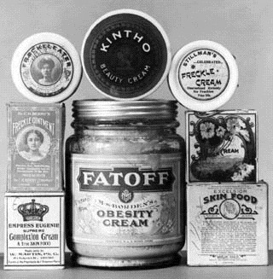

Slide 22
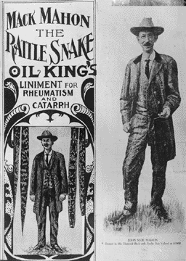

Slide 23
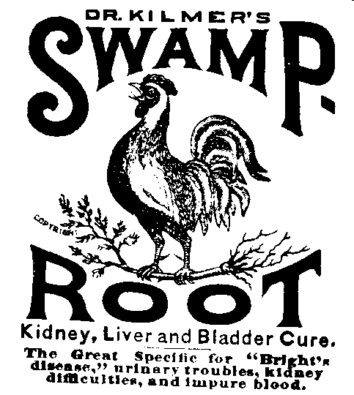
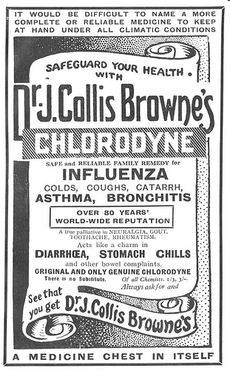
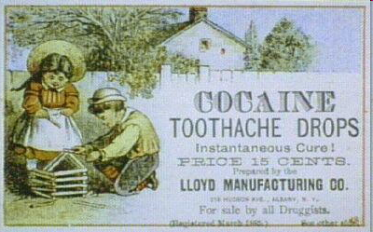
Original formulation contains: laudanum (opium tincture), tincture of cannabis and chloroform.

Slide 24
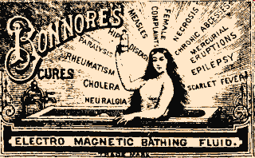
Dr Sibley’s Re-animating Solar Tincture: for restoration of life in cases of sudden death – Britain, late 1700’s to early 1800’s.

Slide 25
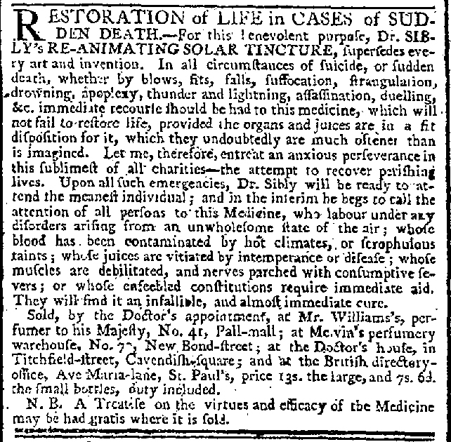
Dr Sibly’s Re-animating Solar Tincture: for restoration of life in cases of sudden death – Britain, late 1700’s to early 1800’s.

Slide 26
Medicines regulation history
First steps (late 1800’s) mainly commercial - to control adulteration
An offshoot of food regulations intended to stop unscrupulous merchants adulterating products
Then extended to misleading labelling - e.g. alcohol, opiates, had to be declared if present
In the US, forerunner of the FDA appeared in late 1800’s and modern functions started by Pure Food and Drugs Act 1906
In UK, a Parliamentary Select Commission was set up in 1912 after two BMA reports on patent medicines, but its report, published on 4th August 1914, was overtaken by the war

Slide 27
Medicines regulation history
In the middle of the 20th century, two incidents precipitated the basic outline of the regulatory structures in the U.S. and the U.K.
These major safety crises - a toxic sulphanilamide elixir in the U.S. (1937) and thalidomide in the U.K. (late 1950’s) - spurred the setup of government bodies to regulate medicines much more closely
Notes:
Sulphanilamide disaster - http://www.fda.gov/AboutFDA/WhatWeDo/History/ProductRegulation/SulfanilamideDisaster/
Thalidomide – e.g. http://broughttolife.sciencemuseum.org.uk/broughttolife/themes/controversies/thalidomide

Slide 28
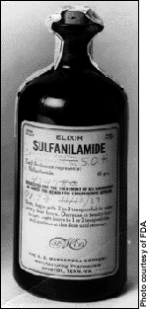
Medicines regulation history - US
In 1937, a US pharmaceutical company produced a sulphanilamide elixir containing diethylene glycol as the solvent: the pharmacist responsible for formulating it was unaware of the toxicity of the solvent and over 100 people died of its effects. At that time, there was no requirement in the US for medicines to be safe. (FDA report).
Notes:
Sulphanilamide disaster - http://www.fda.gov/AboutFDA/WhatWeDo/History/ProductRegulation/SulfanilamideDisaster/
Thalidomide – e.g. http://broughttolife.sciencemuseum.org.uk/broughttolife/themes/controversies/thalidomide

Slide 29
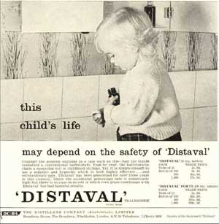
Medicines regulation history UK
The outline of the thalidomide disaster is well known and details widely available: the Science Museum has a summary.
Notes:
Sulphanilamide disaster - http://www.fda.gov/AboutFDA/WhatWeDo/History/ProductRegulation/SulfanilamideDisaster/
Thalidomide – e.g. http://broughttolife.sciencemuseum.org.uk/broughttolife/themes/controversies/thalidomide

Slide 30
Medicines regulation history
In 1962 the Kefauver-Harris amendment to the US Food, Drug & Cosmetic Act of 1938 mandated provision of evidence for medicines safety and – for the first time - efficacy
Medicines would be only licenced if the FDA approved – previously they were licenced automatically unless the FDA objected
  For background, see Dr Frances Kelsey’s story
At present – the aim of regulatory agencies is to ensure safety and (absolute) efficacy; most do not address relative efficacy or economic issues
Often substantially funded by user fees (i.e. from the companies submitting products for licensing)

Slide 31
The MHRA – UK (as of Autumn 2018)
Deals directly only with UK market, though it has close liaison with other authorities, especially EMA;
  a major contributor to current EMA output
  may have EU-wide impact as Reference Member State for mutual recognition process
Publishes an increasing amount of clinical information, especially safety-related items
Status likely to change after UK leaves the EU: the extent will depend on whether there is an agreed exit deal or not, and if so what is included, however procedures are likely to remain very similar.
Notes:
Impact of Brexit not yet known and a major concern to the pharmaceutical industry

Slide 32
The EMA - EU
Advisory scientific agency on medicines for the EU
    works within a collaborative network of national bodies including EEA states
Also advises on herbal medicines for human use (safety only) and veterinary medicines
Human medicines – Committee for Medicinal Products for Human Use (CHMP; the CVMP covers veterinary products)
The Marketing Authorisation is issued by the European Commission, not EMA, but a CHMP opinion is rarely ignored
A product can be licensed in EU countries by several routes:
  EU centralised procedure
  Mutual recognition or decentralised procedure
  Also on a country by country basis through individual regulatory agencies

Slide 33
Licensing – EU
EU centralised procedure – by application to EMA; once approved the Marketing Authorisation is valid throughout the EU and EEA. Mandatory for some medicines, e.g. biologicals, advanced therapies, etc.
EU decentralised procedure* – common assessment of an application simultaneously by several member states, with one state taking a lead (Reference Member State)
Mutual recognition* – initial application made in one member state and once approved other states asked to approve on the basis of this; may involve all or just some other states
* EMA will arbitrate for these in case of dispute, but has no involvement in medicines licensed by individual countries

Slide 34
The FDA - USA
A vast organisation – FDA regulates a wide range of products accounting for about 25% of US consumer spending
  For more see FDA About Basics
Procedures similar to that of other regulatory bodies
US ‘Freedom of Information’ – means a huge amount of information is made available
Website can be difficult to navigate due to sheer size
Drug information is in the CDER section
    http://www.fda.gov/Drugs/default.htm

Slide 35
ICH – towards a standard
ICH – International Conference on Harmonisation
  (of Technical Requirements for Registration of Pharmaceuticals for Human Use)
    http://www.ich.org/
Joint project between regulatory agencies and industry bodies in US, EU, and Japan
  World’s three largest pharmaceutical markets – near 80% of total
  Set up in 1990
Aims to achieve greater harmonisation in technical requirements for pharmaceutical registration
Notes:
Global market shares (2016) - https://www.abpi.org.uk/facts-and-figures/global-pharmaceutical-market/shares-of-the-global-pharmaceutical-markets/

Slide 36
ICH – towards a standard
Object is faster and cheaper authorisation, not necessarily better
No representation from generic industry, consumer groups, etc.
Concerns from independent groups that reducing testing may compromise safety
ICH requirements likely to become de facto standard
Concerns that these may impact on supply of generic essential medicines in less developed countries

Slide 37
Getting medicines to patients faster
The regulatory process and gathering the data required can be time-consuming, so the major agencies have schemes for potentially speeding up the process where a medicine is being developed for a disease with limited or no current effective treatments. These include:
  Orphan status
  PRIME / Breakthrough status
  Conditional licensing
  Adaptive licensing
  Early Access to Medicines Scheme (UK)

Slide 38
Orphan medicines
Principle used by EU and FDA to designate products for rare diseases: EU = orphan medicines; FDA = orphan products (which may include biological products, devices, medical foods)
Criteria similar for both – a product for a serious, rare, disease with limited or no existing therapies
  In Europe, it is the medicinal product not the drug that is licensed, so existing drugs can be given Orphan Status (and advantages) for a new indication under a different brand name (e.g. sildenafil and other PDE-5 inhibitors for pulmonary arterial hypertension)

Slide 39
Orphan medicines
Brings a number of incentives, such as assistance with the regulatory process and a period of market exclusivity
FDA may also provide funding for clinical research
  Further regulatory information at EMA and FDA
Can be controversial due to cost of products but has greatly increased treatments for rare diseases
  Problem – rare diseases are, by definition, rare, however there are many of them (around 7,000) and up to 10% of the population may be affected by a condition defined as a rare disease
  Average annual cost (at list price) of orphan drugs is around five times that of non-orphan medications
  Expected to account for a fifth of prescription drug sales by 2022
    Information from ICER
Notes:
EMA information updated August 2018

Slide 40
PRIME / Breakthrough
EMA ‘PRIME’ (PRIority Medicine); FDA ‘Breakthrough Therapy’
For medicines that are assessed as potentially providing substantial improvement over existing therapy, including in areas of unmet need
Gain enhanced access to regulatory support and expedited regulatory assessment if trial data positive
  The FDA has published a simplified explanation of Breakthrough Therapy and some other processes available in the US for expediting availability of drugs to treat serious disease.

Slide 41
Conditional licensing
Some medicines may be approved with a conditional licence
EMA definition: “The approval of a medicine on the basis of less complete clinical data than are normally required, because it answers an unmet medical need. To gain conditional approval, the available data must indicate that the medicine’s benefits outweigh its risks and the applicant should be in a position to provide the comprehensive clinical data in the future.”
Such medicines will be one (or more) of:
  For serious conditions with limited existing options
  Medicines for emergency situations (e.g. pandemic flu)
  Designated orphan products

Slide 42
Conditional licensing 2
Conditional approval is valid for a year, renewable, and subject to post-marketing studies to confirm benefit-risk balance is positive
Will often use surrogate endpoints and there is debate over validity of these – e.g. see JAMA Intern Med. 2015;175(12):1992-1994
The Canadian study quoted previously noted that medicines with priority review were more likely to be removed for safety reasons or receive a ‘black box’ emphasised safety warning
Notes:
Meta-analysis on (poor) validity of surrogate endpoints in oncology
http://archinte.jamanetwork.com/article.aspx?articleid=2323416

Slide 43
‘Adaptive licensing’ - EMA
Not conditional licensing, as above, but may include it
‘Iterative licensing’ initial approval for use in a restricted patient group, with use then gradually expanded to broader patient populations as more safety and efficacy data are generated
Early involvement of patients and health technology assessment bodies expected in discussions on a medicine’s development.
Intended to apply mostly to treatments in areas of high medical need where it is difficult to collect data via traditional routes and where large clinical trials would unnecessarily expose patients who are unlikely to benefit - EMA information

Slide 44
‘Early Access to Medicines’
MHRA scheme for UK
Intended to allow patients access to medicines for treatment of life threatening or seriously debilitating conditions where there is an unmet need, before formal licensing
Launched April 2014; up to 13/11/18, 21 applications received an EAMS PAR (2 remain active - http://tinyurl.com/honubdh)
Three-step voluntary procedure:
  Promising Innovative Medicine (PIM) designation
  EAMS Scientific Opinion, normally based on completed P3 trial data, with an EAMS PAR issued on completion
  Commissioning by NHS England
Notes:
Expired products:
Alectinib (NSCLC)
Duplilumab (atopic dermatitis)
Glecaprevir/Pibrentasvir (chronic HCV)
Oxervate (neurotrophic keratitis)
Atezolizumab (bladder cancer)
Nivolumab (for lung cancer)
Pembrolizumab (melanoma)
Sacubitril/valsartan (heart failure)
Osimertinib (NSCLC)
Pembrolizumab (NSCLC)
Nivolumab (for melanoma)
Venetoclax (CLL)
Nivolumab (Hodgkin lymphoma)
Nivolumab (renal cancer)
Nivolumab (lung cancer, advanced)
Emicizumab (for routine prophylaxis of bleeding episodes in patients, aged 1 year and over, with haemophilia A with factor VIII inhibitors)
Nivolumab to treat advanced or recurrent gastric or gastroesophageal junction cancer after two or more systemic therapies
Current products:
Idebenone (Raxone) to treat the decline of respiratory function in patients with Duchenne Muscular Dystrophy
Volanesorsen as a treatment of adult patients with familial chylomicronaemia syndrome

Slide 45
‘Early Access to Medicines’
Once passed for EAMS, regular updates from the manufacturer to the MHRA are mandatory
Originally unfunded – companies expected to provide medicines for free, so criticised for favouring large companies and providing incentive for manufacturer to minimise time in the scheme (e.g. this ABPI review). An independent review of EAMS (March 2016) recommends providing funding for products from smaller companies
EAMS approval expires once the medicine is formally licensed.
EAMS – Early Access to Medicines Scheme
Notes:
Expired products:
Nivolumab (for melanoma)
Nivolumab (for lung cancer)
Pembrolizumab (for melanoma)
Sacubitril/valsartan (for heart failure)
Current product:
Osimertinib

Slide 46
Regulatory approval vs. HTA – what’s the difference?
There may sometimes be confusion between regulatory approval and Health Technology Assessment (HTA)
Regulatory approval:
  Fundamentally to confirm absolute efficacy (‘does it work?’) and safety (‘is it acceptably safe for the intended indication?’), but covers far more including pharmaceutics, manufacturing, dose form stability, animal toxicology, etc.
  Based on information dossier provided by the manufacturer, most of which will be in-house and confidential

Slide 47
Regulatory approval vs. HTA – what’s the difference?
HTA:
  Aim - to decide ‘place in therapy’ and ‘value for money’
  Interested in relative efficacy (‘does it work better than what we use now?’)
  Will look at relative safety (‘is it as safe as or safer than what we use now?’) and adverse effect profile (‘is it likely to spring any safety surprises?’)
  May consider service implications (e.g. ‘is it easier to administer?’ or ‘does it need special tests before use, or expensive monitoring?’)
  Based on peer-reviewed published information wherever possible
  Cost a factor, both absolute and relative to existing therapeutic options (‘is this new medicine a reasonable use of our scarce healthcare resources?’)

Slide 48
What stage is a drug at?
Basic information often easy – most manufacturers have this on their website
  under ‘pipeline’ or ‘research’; may be in Information for Investors section
Don’t forget the media – including the Web
  beware – much of this is unbalanced, for example from PR agencies (for a rather elderly discussion of this problem see http://www.policyalternatives.ca/publications/reports/drugs-news), or from a source with a particular agenda (e.g. media reporting of MMR, SSRI). See NHS Choices ‘Behind the Headlines’ for good assessments of the latest ‘breakthroughs’.

Slide 49
What information is available?
Regulatory agencies require a great deal of information for licensing – only part of this is directly clinical
Some will be published before launch – e.g. basic research, phase 2 studies
  Companies will manage a publication strategy - “just enough, just in time” (e.g. abstracts and sponsored symposia) followed by exponential “share of voice” launch publications.
  All the information will not necessarily be published – beware publication bias (e.g. see PLoS Med 2008; 5(9): e191 doi:10.1371/journal.pmed.0050191; and BMJ 2013; 347:f6104)
Company is the only source before licensing

Slide 50
Getting information after licencing
After licensing, the FDA, EMA and MHRA post Web dossiers
Information on mutual recognition and decentralised procedure drugs may be available from the HMA website
  HMA – website for EU/EEA Heads of Medicines Agencies
Company must supply any information requested by a clinician (including ‘data on file’)
  frequently have formulary/review packs, but these will be biased to positive view
Clinical trials starting to appear in the literature
  literature searching – remember Medline is not fully comprehensive and PubMed (based on Medline) is the most up to date
  not all trials will be published (and those that are not may change your view - BMJ 2010;341:c4737)

